Slide 1
Demystifying Data Roles
An Overview of Critical Data Roles

Slide 2
Why does this matter?
Establishing expectations for various data roles.
Helping answer what role would provide the best value for my team?
Clearing up confusion on data roles.

Slide 3
From a business Perspective
What does your business want?
Data Products
Data Visuals
Data Quality
Data Life Cycle
What is needed… generally?
Data Architecture
Data Governance & Quality
Daa Product
Software

Slide 4
Data Products
What does this mean?
AI Product
Smart Speaker Example
ML Product
Descriptive
Predictive
Recommendation
Who produces these type of data products?
Data Scientists/Machine Learning Engineer
Data Engineers
Data Architects
MLOps Engineers
Needed Skillsets?
Language (Python, R, SQL, DAX, etc.)
ML Library

Slide 5
Data Visuals
What does this mean?
Answer questions of my data.
How many people visited our website and from what region?
Plot my bank balances over time?
What is the breakdown of items sold at my company in the last year?
Who typically does this kind of work?
Data Analysts
Data Scientist
Needed Skillset?
Whatever produces the visuals you are looking to convey your point.

Slide 6
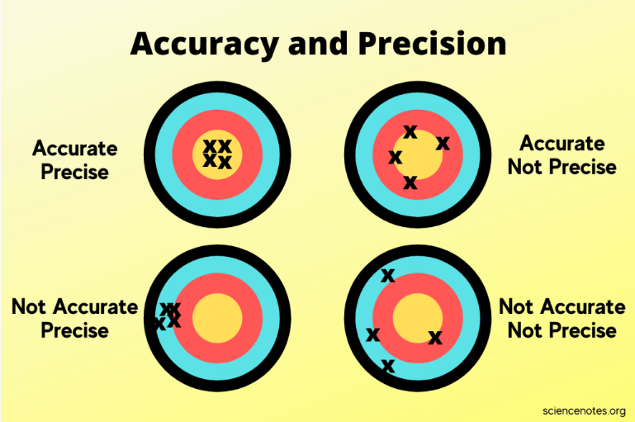
Data Governance and Quality
THIS SHOULD BE A CONSTANT FOR ANY ORGANIZATION!
What does this mean?
Ensuring that data is accurate and precise.
Cleans up data
Maintains data
Who does this kind of work?
SQL Database Administrator
Data Engineer
Needed skillsets?
SQL, Python, R, DAX, etc.

Slide 7
Data architecture
What does this mean?
Someone who understands the flow and how data moves through your org.
Who does this kind of work?
Data Architect
Architect
Data Engineer
Needed Skillset?
YAML
Terraform
Depends on the architecture you choose.

Slide 8
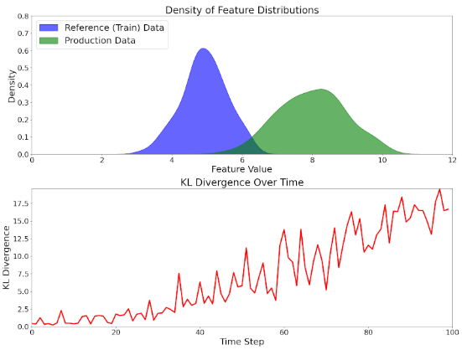
Data Life Cycle
Data Products
Build model
Deploy model
Improve Model
Data Visuals
Build Visual
Maintain Visual
Data Quality
Data Testing

Slide 9
Software
What does this mean?
Being able to answer HOW a problem is being answered, solved, solutioned, etc.
Who does this kind of work?
Software engineers
Needed skillsets?
Yes.

Slide 10
Organizational Structure
Welllll, it depends on the business needs.
Sharing stories from my industry experience.

Slide 11
Common Career Paths
Sharing some stories from the field.

Slide 12
Common Misunderstandings or problems
Job inflation and Overlap
Data Scientist
Data Analyst
Data can solve everything!
I can just use AI for everything!
Trend that I noticed while job searching.
I can get 100% accuracy in my Machine Learning Model.

Slide 13
Summary
Keys roles:
Data Scientist
Data Analyst
Data Engineer/ML-Ops
Data Quality and Governance

Slide 14
Questions?

Slide 15
NO?
Can I interest you in some memes?

Slide 16
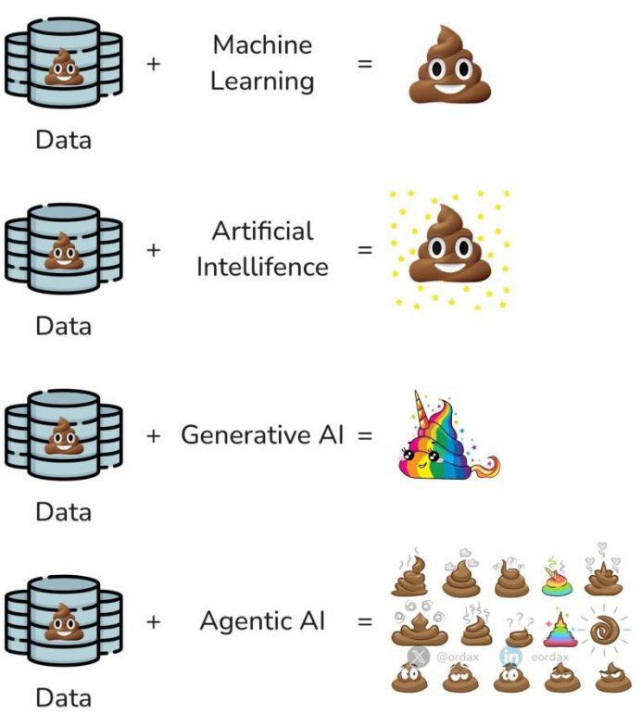
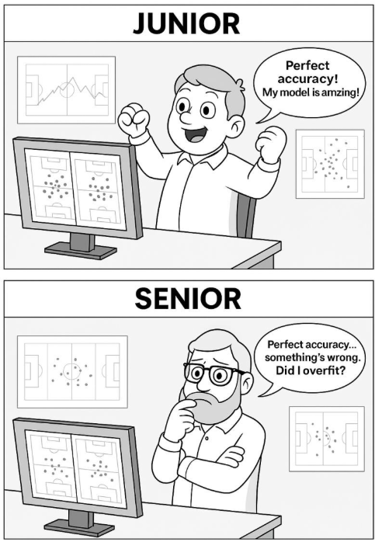

Slide 17
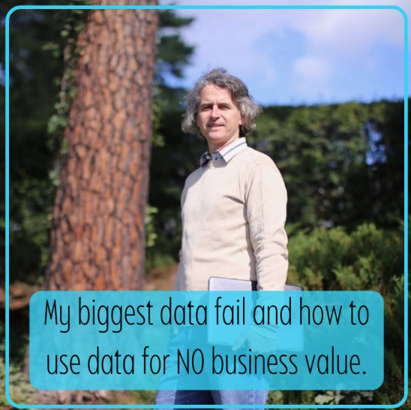
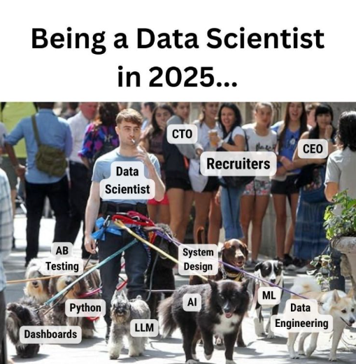

Slide 18
